Slide 1

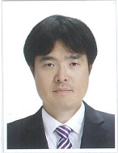

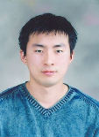
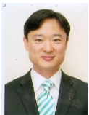
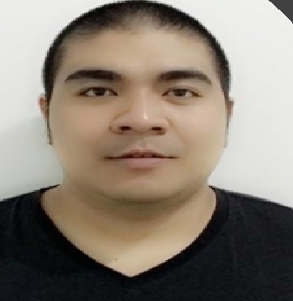


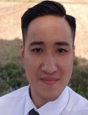




GEELY CX11 EU ST – Organization
VN Test Team
HQ Test Team
Truong Dao
Alex Won
Part Leader
Project Owner
Bich Do
Jin-hyun Park
Kevin We
Test Leader
Project Manager
Project Manager
Dat Nguyen
Nam Ta
Audio, Entertainment
HMI M&D, Infotainment Platform
Tuan Nguyen
Lan Vuong
HMI M&D, Telephony
HMI M&D
Kien Vu
Xen Le
HMI M&D
HMI M&D
Ngoc Nguyen
HMI M&D
New members
Leaders
Function Leader
R&R of Vietnam validation team for Geely CX11 EU ST project Develop TC for CX11 base on new changes Verify OEM defects System test (Full validation) Exploratory Testing
Month | 2020 |  |  |  |  |  |  | 2021
 | 6 | 7 | 8 | 9 | 10 | 11 | 12 | 1 | 2 | 3 | 4 | 5 | 6 | 7 | 8 | 9 | 10 | 11 | 12
DCV TL | 0.5 | 1 | 1 | 1 | 1 | 1 | 1 | 1 | 1 | 1 | 1 | 1 | 1 | 1 | 1 | 1 | 1 | 1 | 1
DCV Tester | 0.5 | 1 | 1 | 1 | 1 | 1 | 1 | 1 | 1 | 1 | 1 | 1 | 1 | 1 | 1 | 1 | 1 | 1 | 1
Total DCV | 0.5 | 2 | 2 | 2 | 2 | 2 | 2 | 2 | 2 | 2 | 2 | 2 | 2 | 2 | 2 | 2 | 2 | 2 | 2
FPT Senor | 2 | 2 | 2 | 2 | 2 | 2 | 2 | 2 | 2 | 2 | 2 | 2 | 2 | 2 | 2 | 2 | 2 | 2 | 2
FPT Junior | 0 | 4 | 4 | 4 | 4 | 4 | 4 | 4 | 4 | 4 | 4 | 4 | 4 | 4 | 4 | 4 | 4 | 4 | 4
FPT_Total | 2 | 6 | 6 | 6 | 6 | 6 | 6 | 6 | 6 | 6 | 6 | 6 | 6 | 6 | 6 | 6 | 6 | 6 | 6
Total | 2.5 | 8 | 8 | 8 | 8 | 8 | 8 | 8 | 8 | 8 | 8 | 8 | 8 | 8 | 8 | 8 | 8 | 8 | 8

Slide 2
GEELY CX11 EU ST – Project Progress – Test Result
$True−Defect Rate=(\frac{Closed Defect (Except:Not a bug, Duplicate+Resolved Defect }{Total Closed Defect }$)*100%
Notes:
Test environment is more stable
Pass rate has increased
Tester run the same TCs with Aug, the same TCs for CX11 EU and CX11 20A -> Got used to those TCs.

Slide 3
GEELY CX11 EU ST – Plan & Request
Monthly activities
Activity of Oct | Oct’s actual result | Nov’s progress | Remark
Execute test FV4 for CX11 EU on IP739 (10/06~10/28) ~ 2516 TCs | - Completed 100% (2516/ 2516 TCs) on Oct 15th. Pass rate 95% | - Sanity test on IP740.04 (11/11~11/11) ~ 303 TCs - Sanity test on IP740.05 (11/12~11/13) ~ 303 TCs - Develop TCs for new changes | Done Sanity test
Investigate OEM defect (10/26 ~ 10/30) ~240 defects | - Completed 100% ( 240/ 240 defects) - 191/ 240 defects need creating TCs to cover defect content | - Verify OEM defects (11/06~11/09) ~ 38 defects Closed: 13 Reopened: 0 NT: 25 | 25 defects cannot verify due to poor test environment ( Do not have Rig, user profile, TEM, DTC, Navigation) or need to test on a real car.
Exploratory testing (10/16~10/23) | - 6 defects found. | - Exploratory Testing on IP740.05 for CX11 EU (11/09~11/10). 11 new defects found. - Exploratory Testing on IP740.05 (11/23~11/30)
Issue & Request
No. | Description | Type | Cause / Request / Action Plan / Progress | PIC
1 | Cannot start create TCs base on new changes | Issue | The release note has not been delivered yet due to a delay from Development team. Mr. Park will send when he get it. | Mr. Jin- Hyun Park
2 | Long term validation and Resource plan | Request | Please share with us long term validation plan and resource plan for this project | Mr. Won

Slide 4


Slide 5
GEELY CX11 EU ST – Effort Distribution
Total Effort Distribution
Notes:
Pass rate:
CX11 EU: has increased from 90% (July) to 94% (Aug)
CX11 20A: has increased from 98% (July) to 100% (Aug)

